Slide 1
Go microservices

Slide 2
Outline
Microservice definitions and contextualization
Go and Go kit
A Go kit microservice from first principles

Slide 3
Follow along
•
Install Go — http://golang.org — brew install go
•
$ export GOPATH=$HOME/gocode # or somewhere else
•
$ go get github.com/peterbourgon/go-microservices

Slide 4
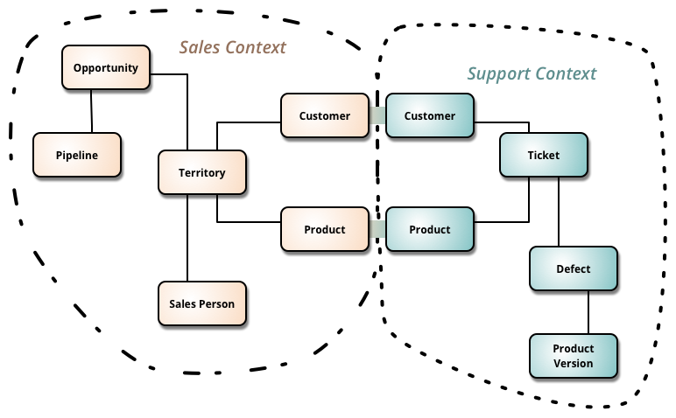
martinfowler.com/bliki/BoundedContext.html

Slide 5
Operation
Microservices built & deployed independently.
Stateless, with state as backing services.
Addressable through a service discovery system.

Slide 6
Architecture
•
CRUD-oriented
•
Typically RPC, often HTTP
•
Request processing
•
Monolith → microservices
•
Ruby on Rails; Tomcat/Jetty, Spring Boot; Akka, Play

Slide 7

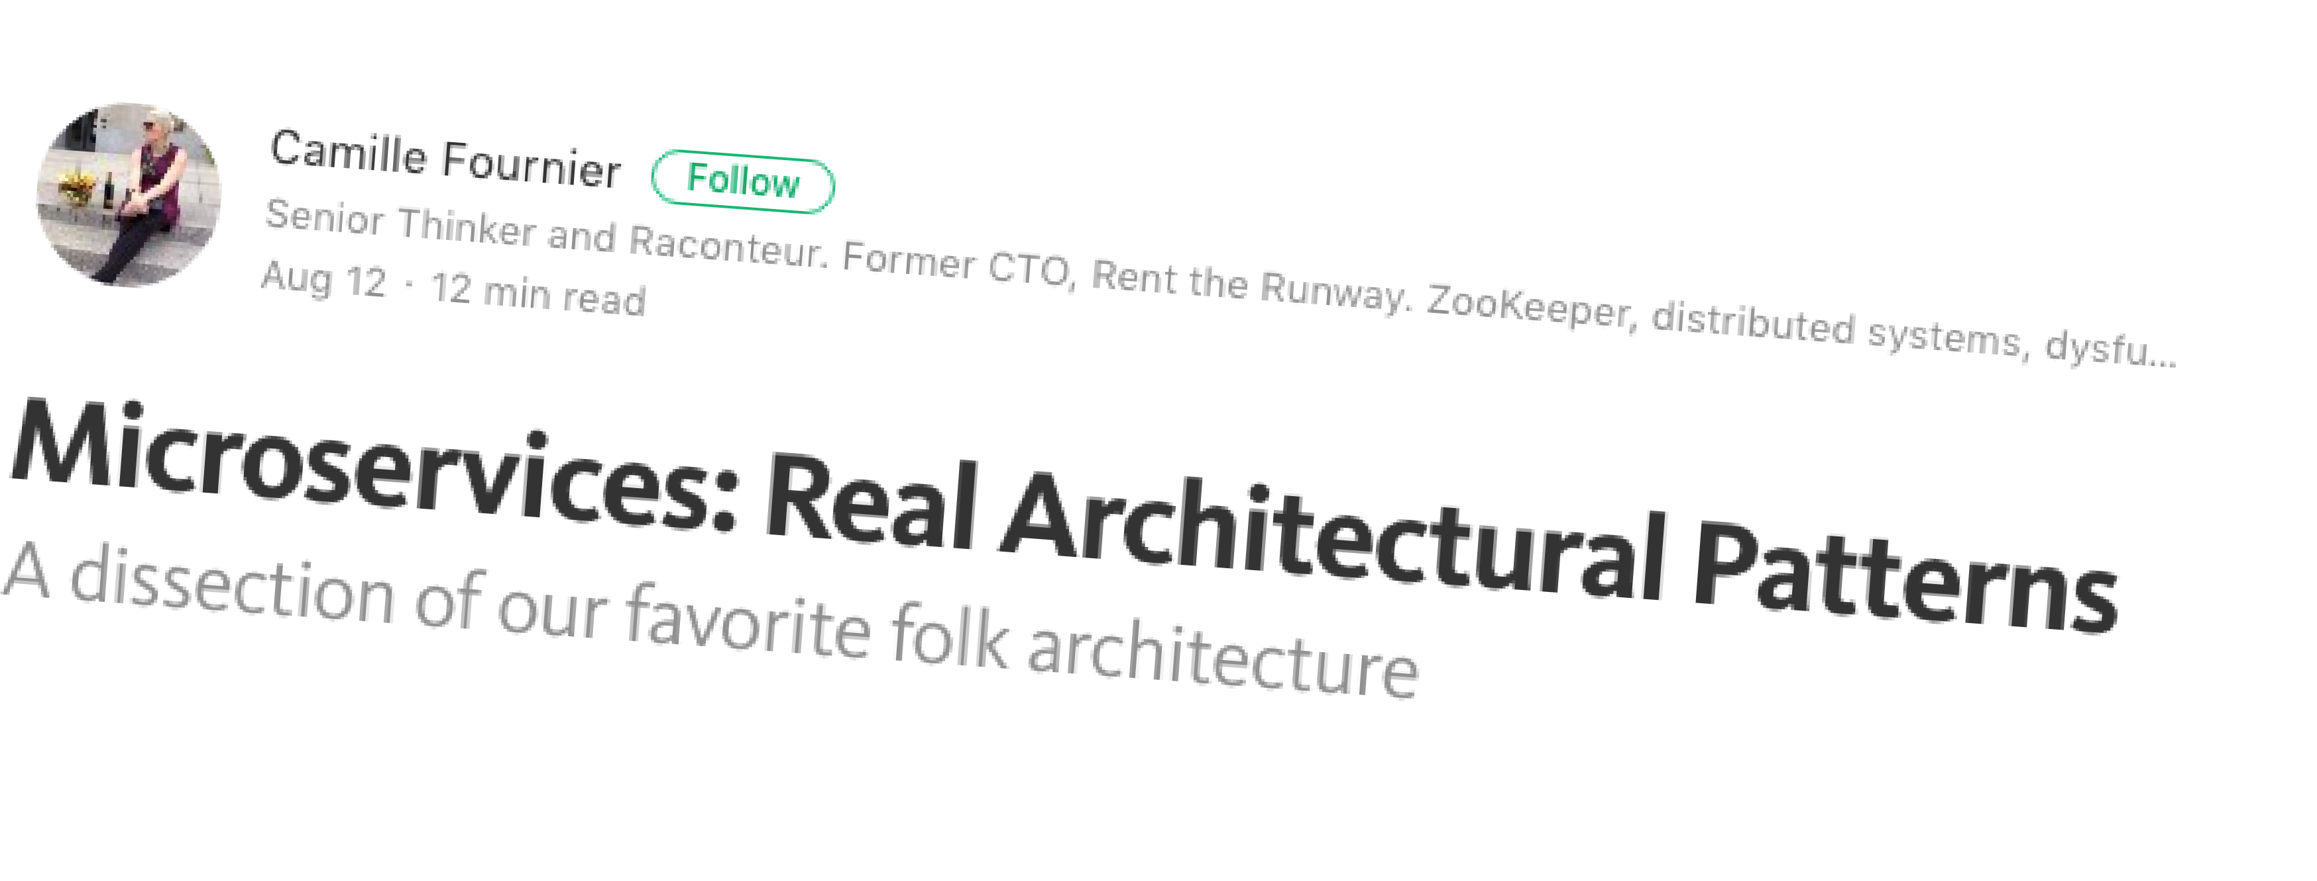
Did you mean...
•
Stream-oriented
•
Event sourcing
•
Message processing
•
Materialized views
•
SQS, Kinesis, Kafka, RabbitMQ, Storm...

Slide 8
Intermediate architectures
}
Pure RPC
Messaging
Stream processing
HTTP, binary
RabbitMQ, NATS, NSQ, SQS, Kafka...
Kafka, Storm
It's a spectrum

Slide 9
Microservices solve
organizational problems
V
Microservices cause
technical problems

Slide 10
Problems solved
•
Team is too large to work eﬀectively on shared codebase
•
Teams are blocked on other teams — can't make progress
•
Communication overhead too large
•
Velocity stalled

Slide 11
Problems caused
•
Need well-defined business domains for stable APIs
•
No more shared DB — distributed transactions?
•
Testing becomes really hard
•
Require dev/ops culture: devs deploy & operate their work
•
Job (service) scheduling — manually works, for a while...

Slide 12
Problems caused
•
Addressability i.e. service discovery
•
Monitoring and instrumentation — tail -f? Nagios & New Relic? Ha!
•
Distributed tracing?
•
Build pipelines??
•
Security???

Slide 13


Monolith

Slide 14

Microservice

Slide 15
Microservices

Slide 16
Microservices

Slide 17
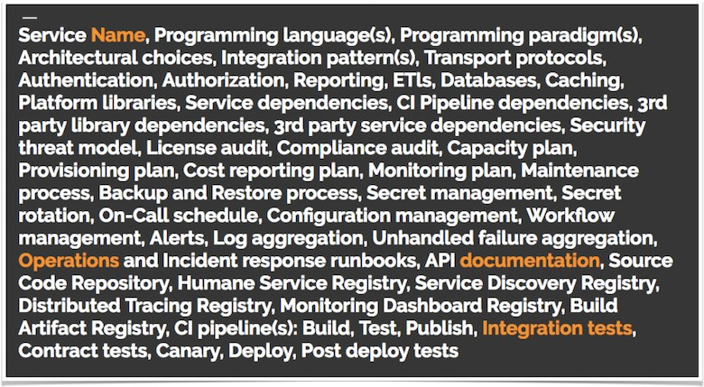
From one to many
Concerns for a single service, Sean Treadway, SoundCloud

Slide 18
Think twice
•
Most [small] organizations don't need microservices
•
5 or fewer engineers? You definitely don't need microservices
•
Building an AMI for an EC2 autoscaling group works really really well

Slide 19
•
Sense of ownership & responsibility → quality
•
Confidence → Always Be Refactoring
•
Align incentives with the business
•
peter.bourgon.org/a-case-for-microservices

Slide 20
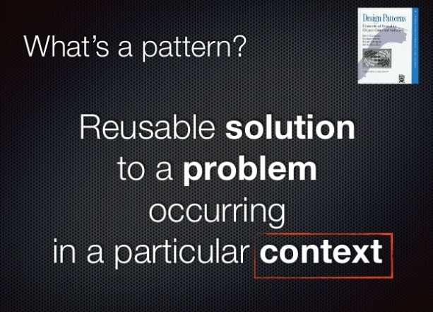

Slide 21
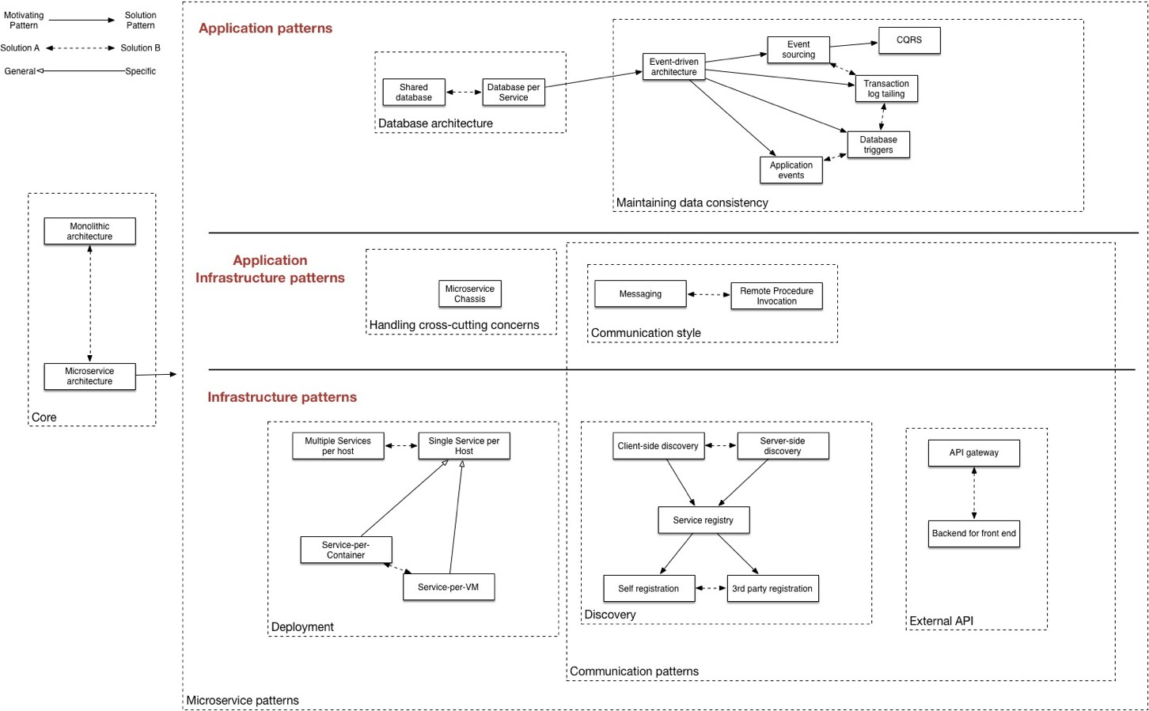

Slide 22
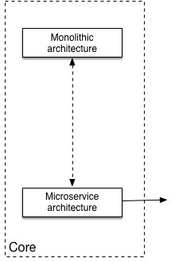

Slide 23
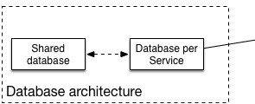

Slide 24
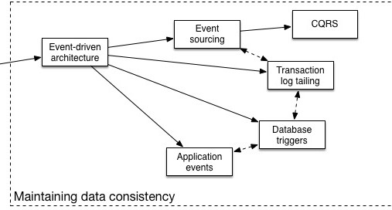

Slide 25
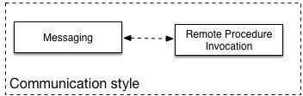

Slide 26
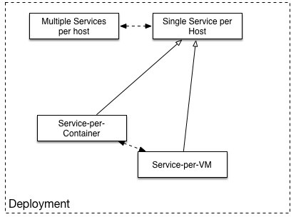

Slide 27
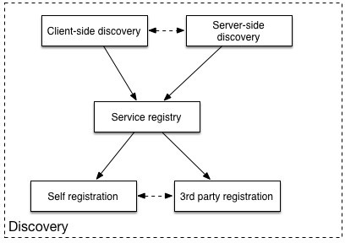

Slide 28
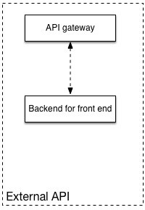

Slide 29







Structured
Exception tracking
Unstructured
Audit logging
File
Application logging
Stream
Application metrics (instrumentation)
Push
Pull
Distributed tracing
Observability

Slide 30
Why Go?

Slide 31
Facts about Go
•
Statically typed
•
Looks like C
•
Compiled — fast!
•
Big standard library
•
Native binaries
•
Baked-in concurrency
•
Garbage collected
•
Native networking

Slide 32
Go, IMO
•
A breath of fresh air from "kitchen sink" languages (cf. Scala)
•
Simple, orthogonal features that aren't surprising (cf. Node)
•
Eﬃcient by default (cf. Python, Ruby)
•
Predictable runtime behavior, fast lifecycles (cf. all JVM languages)
•
Familiar heritage, syntax, and paradigm (cf. Haskell, Elixir)

Slide 33
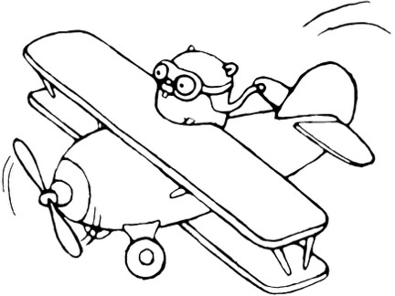
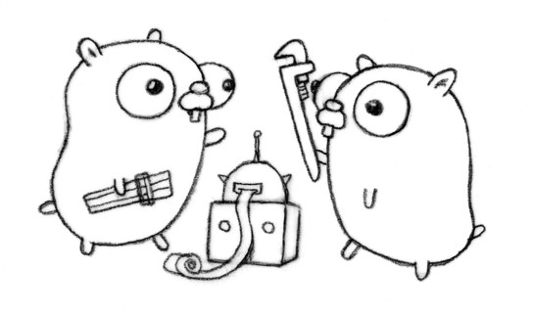
Exercise
Go language introduction/refresher

Slide 34
Go for servers
•
Often the best language for writing servers
•
Why not the best language for writing microservices?

Slide 35
Enter Go kit

Slide 36
Concerns + patterns
Toward some kind of software engineering

Slide 37
Transport
Service registration
Load balancing
Business logic
Metrics
Circuit breaking
Service discovery
Rate limiting
Logging
Distributed tracing

Slide 38
Transport Rate limiting
Circuit breaking
Service registration Service discovery Load balancing
Business logic
Metrics Logging
Distributed tracing

Slide 39
Transport Rate limiting
Circuit breaking
Service registration Service discovery Load balancing
Business logic
Metrics Logging
Distributed tracing

Slide 40
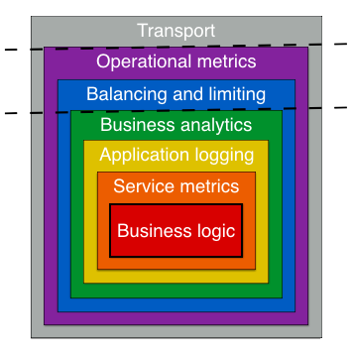

Slide 41
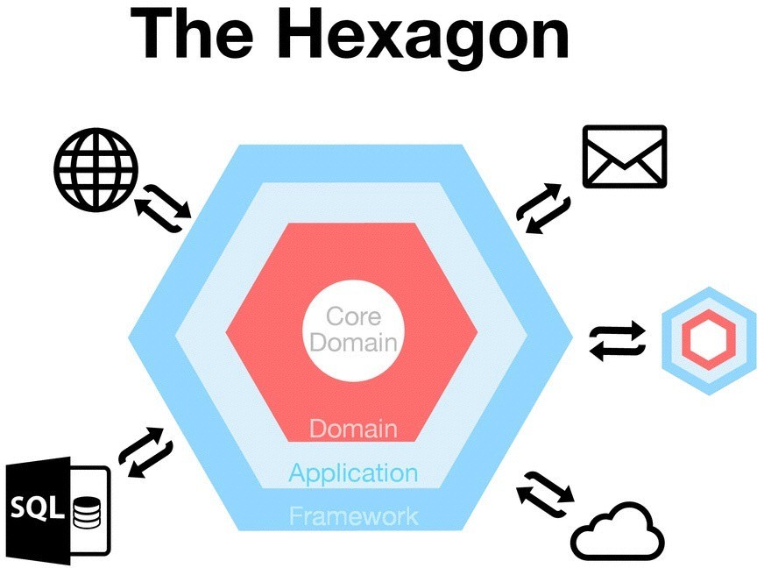

Slide 42
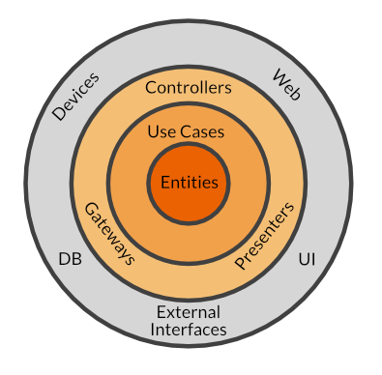
The central rule of The Clean Architecture is the Dependency Rule, which says
Source code dependencies can only point inwards.

Slide 43
Exercise
Given billingsvc, place all of these concerns in our model:
•
•
•
•
•
•
Customer ID
HTTP request decoding Max 1 QPS per origin IP Log each account credit Log each account debit Log each error
•
•
•
•
•
•
•
•
•
Track overall credit rate Track overall debit rate
Make service reachable by frontend Spread load over diﬀerent services
Stop cascading failure with circuit breaker Trace requests with correlation ID
Monitor request durations Monitor error rates Dispute ID

Slide 44
Go kit: the pitch
•
Make microservice concerns tractable
•
Make Go attractive to your organization
•
Play nicely with others

Slide 45
Go kit: not a framework
•
Not like other Go projects: Revel, Beego, Kite, Micro, H2, gocircuit...
•
More like Gorilla
•
Use what you need
•
Progressive enhancement

Slide 46
Go kit: compare to...
•
Finagle (Scala) — initial inspiration
•
Netflix OSS: Eureka, Hystrix, Zuul, etc. (JVM) — similar goals
•
Spring Boot (Java) — similar goals, radically diﬀerent approach
•
Nameko (Python) — similar goals
•
Others?

Slide 47
Go kit: philosophy
•
Exemplify Go best practices
No global state
Declarative composition
Explicit dependencies
Interfaces as contracts
•
Toward a software engineering
SOLID Design
Domain Driven Design
The Clean Architecture
Hexagonal Architecture

Slide 48
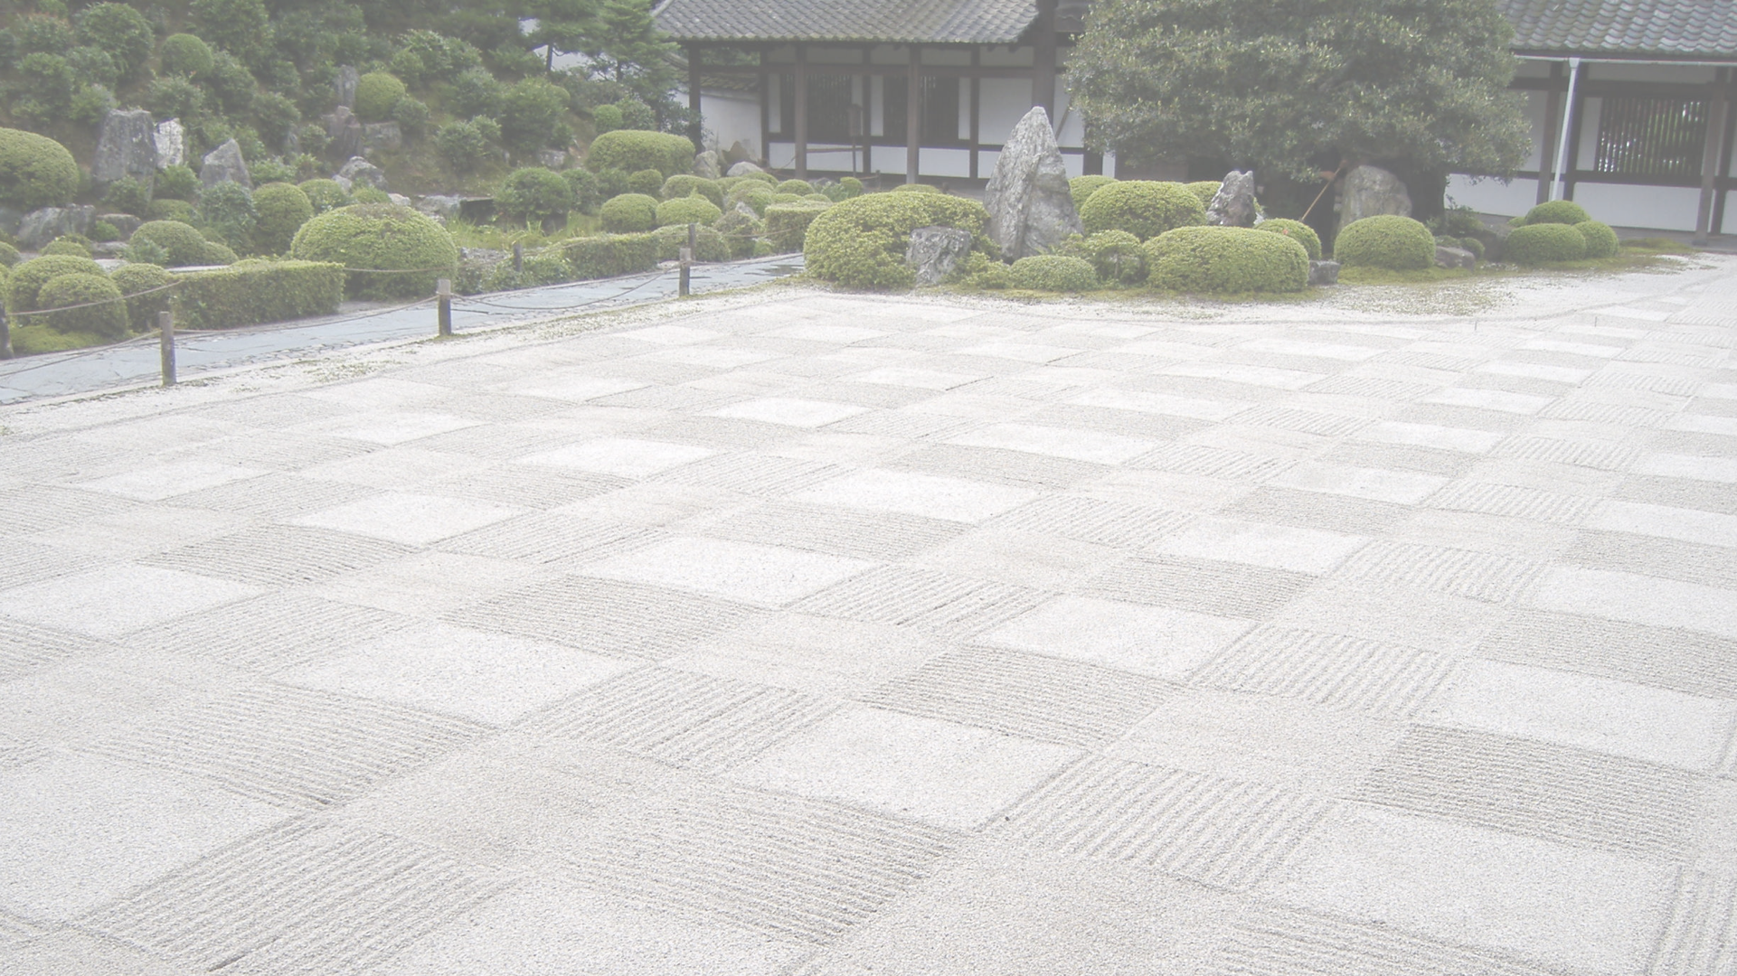
My little zen rock garden

Slide 49
addsvc
The naïve implementation

Slide 50

Code
01

Slide 51
addsvc
Structure & scaﬀolding

Slide 53
Decorators
func instrument(...) {
// proceed as normal
func foo(...) {
// business logic m.With(method, code).Observe(t)
}
}
func log(...) {
// proceed as normal log.Printf("...")
}
func rateLimit(...) {
if aboveThreshold {
error
}
// proceed as normal
}

Slide 54
Endpoint
•
Generalize each operation as RPC: request, response
type Endpoint func(request) response
Accommodate failure and request-scoped information
•
•
type Endpoint func(ctx context.Context, request interface{}) (response interface{}, err error)
•
Empty interface? Empty interface :(

Slide 55
Code
02

Slide 56
addsvc
Decorators & middlewares

Slide 57
Instrumenting

Slide 58






Structured
Exception tracking
Unstructured
Audit logging
File
Application logging
Stream
Application metrics (instrumentation)
Push
Pull
Distributed tracing
Observability

Slide 59

White box monitoring
Black box monitoring

Slide 60

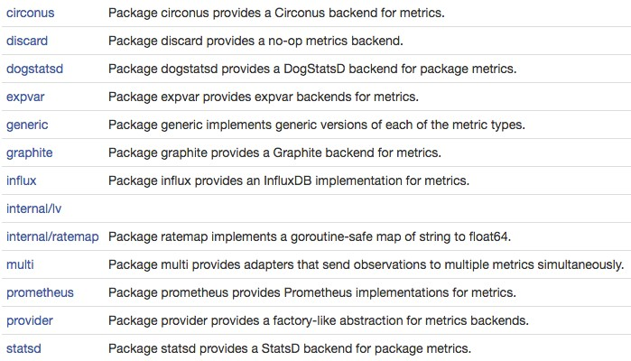

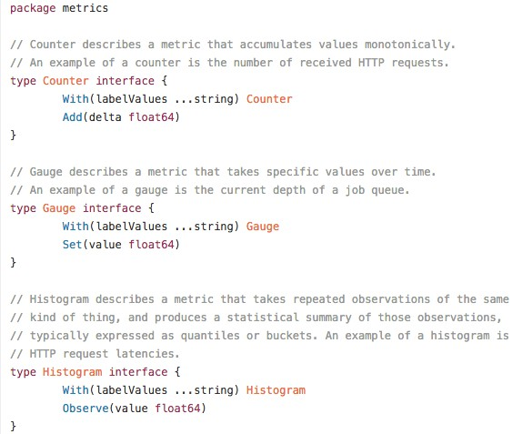

Slide 61
USE method
Brendan Gregg
RED method
Tom Wilkie
Utilization Saturation
Error count (rate)
For resources e.g. queues
Request count (rate) Error count (rate) Duration
For e.g. endpoints

Slide 62
Code
03

Slide 63
Logging

Slide 64

Structured
Exception tracking
Unstructured
Audit logging
File
Application logging
Stream
Application metrics (instrumentation)
Push
Pull
Distributed tracing
Observability

Slide 65
Compare/contrast
•
log.Infof("HTTP server listening on %s", httpAddr)
•
2016-10-31 11:43:06 [INFO] main.go:78: HTTP server listening on :8080
•
level.Info(logger).Log("transport", "HTTP", "addr", httpAddr)
•
ts="2016-10-31 11:43:06" caller=main.go:78 level=info transport=HTTP addr=:8080
•
{ "ts": "2016-10-31 11:43:06", "caller": "main.go:78", "level": "info", "transport": "HTTP", "addr": ":8080" }

Slide 66
Benefits
•
Machine parseable
•
Unit testable
•
No less readable, especially logfmt
•
Chris Hines — The Hunt for a Logger Interface

Slide 67
Logs are streams, not files
•
You may not have a filesystem, write privileges, etc.
•
You probably want aggregation — implies platform involvement
•
stdout/stderr is a much better contract
•
12factor.net

Slide 68
Code
04 — main.go, endpoints, service

Slide 69
Safety

Slide 70





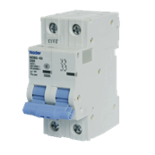




Slide 71
Code
05 — Endpoints middleware

Slide 72







HTTP Mux
HTTP Server
HTTP Server
CB
CB
RL
RL
Sum
Concat
Logging
Service

Slide 73




HTTP Mux
HTTP Server
HTTP Server
CB
CB
RL
RL
Sum
Concat
Logging
Service
gRPC Server gRPC Server gRPC Mux

Slide 74
addsvc
Cross-cutting concerns

Slide 75
Error mapping

Slide 76


POST /sum
ErrTwoZeroes
HTTP 400

Slide 77
Code
06 — Service, HTTP

Slide 78
Context

Slide 79
X-Request-ID
X-Request-ID

Slide 80
Code
07 — Service, endpoints

Slide 81
Distributed tracing

Slide 82


Client
A
C
B
F
D
E

Slide 83
Client
A
F
B
C
D
E

Slide 84




Client
F
A
B
C
D
E

Slide 85






_{Clien} +TraceID T1_{A}
F
B
C
D
E
t
+SpanID S1

Slide 86
=TraceID T1
F
_{Clien} +TraceID T1_{A}
C
D
E
t
B
+SpanID S2
+SpanID S1
~ParentSpanID S1

Slide 87
=TraceID T1
F
_{Clien} +TraceID T1_{A}
C
D
E
t
B
+SpanID S2
+SpanID S1
~ParentSpanID S1
=TraceID T1
+SpanID S3
~ParentSpanID S2

Slide 88
Client
F
A B
Server Receive @ t=0
C
D
E
Client Send @ t=1 Client Receive @ t=2
Server Send @ t=3

Slide 89

Client
F
A B
Server Receive @ t=0
C
D
E
Span
Client Send @ t=1 Client Receive @ t=2
Server Send @ t=3

Slide 90
Client
F
A
B
C
D
E
Span

Slide 91






Client
A
F
B
C
D
E
Span
Span
Span
Span
Span
Span
Span

Slide 92
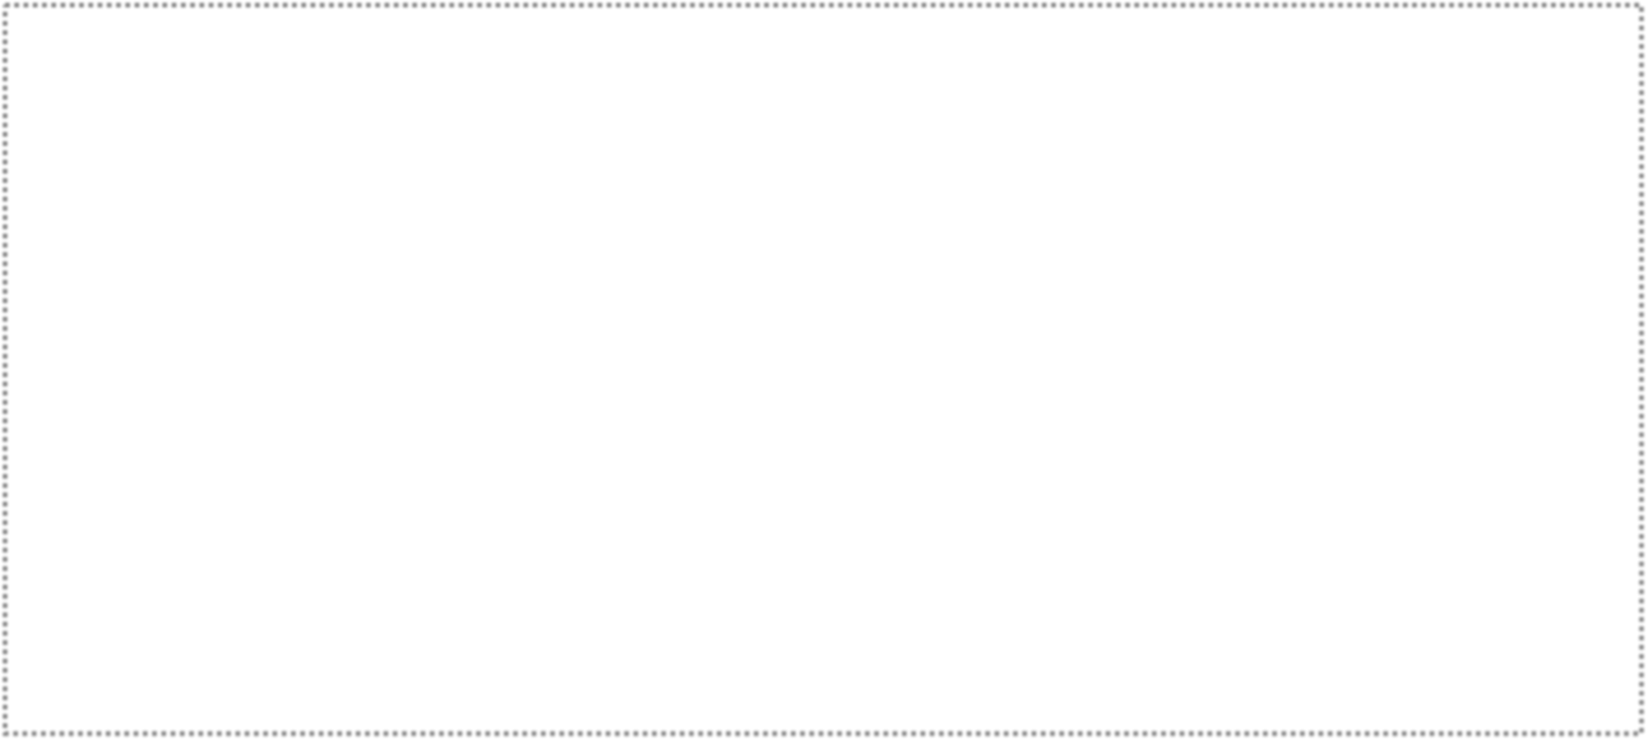
Tra^{C}ce
A
F
Client
B
D
E
Span
Span
Span
Span
Span
Span
Span

Slide 93

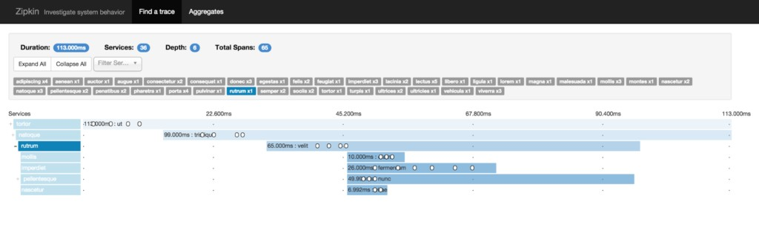

Slide 94
Code
08 — main.go, HTTP, endpoints

Slide 95
addsvc
Testing

Slide 96
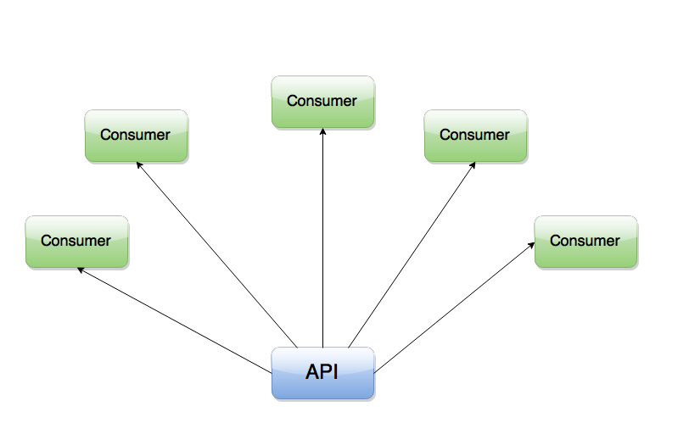

Slide 97
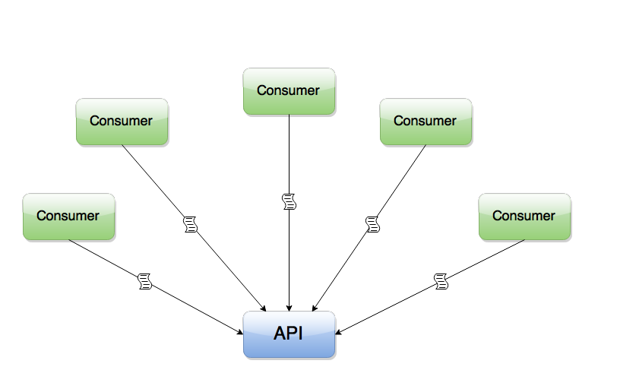

Slide 98

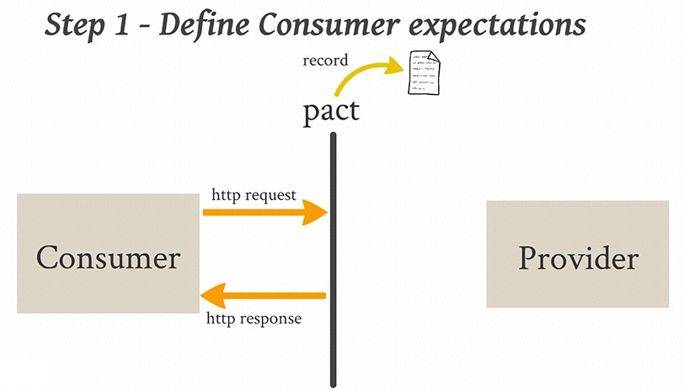
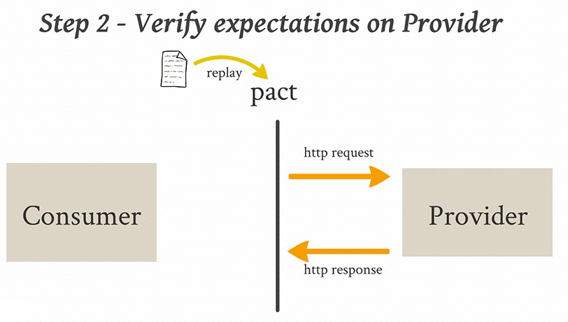

Slide 99
Code
09 — stringsvc and Pact

Slide 100
What about unit tests?
•
Contract tests give us the freedom to refactor as necessary
•
Unit tests make that process faster
•
Test the thing being tested, and nothing more
•
Mitchell Hashimoto — Advanced Testing with Go
•
peter.bourgon.org/go-best-practices-2016/#testing

Slide 101
What about integration tests?
•
Integration tests can mean diﬀerent things
For a single service: test DB, etc. — use Docker
For many services: test interactions — already covered by contracts!
With microservices, there is no steady state
•
•
Google Testing Blog: Just say no to more end-to-end tests

Slide 102
Integration
The Testing Pyramid
Contract
Unit
Start here!

Slide 103
Code
10 — Wiring test

Slide 104
Bonus: service discovery
Go kit's package sd

Slide 105

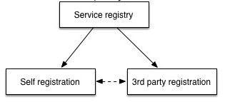

Slide 106



Registration
Registry
Consul, etcd, ZooKeeper
B
A
B
B

Slide 107
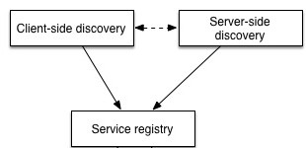

Slide 108
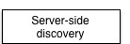

Slide 109

Central load balancer
Registry
Consul, etcd, ZooKeeper
B
A
LB
B
B

Slide 110
Central load balancer
Registry
Consul, etcd, ZooKeeper
B
A
LB
B
B

Slide 111
Central load balancer
C
B
A
LB
B
B
D

Slide 112

Central load balancer
C
B
A
LB
B
B
D

Slide 113




Central load balancer
C
😰
B
A
LB
B
B
D

Slide 114
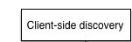

Slide 115
Client-side load balancer
Registry
Consul, etcd, ZooKeeper
B
A
LB
B
B

Slide 116

Deregistration
Registry
Consul, etcd, ZooKeeper
1. Deregister
2. Notify
B
3. Teardown
A
LB
B
B

Slide 117
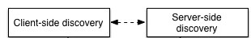
It's a spectrum

Slide 118
Client-side
Registry
Consul, etcd, ZooKeeper
B
A
LB
B
B

Slide 119
Linkerd sidecar
Registry
Consul, etcd, ZooKeeper
B
A LB
B
B
Pod or container

Slide 120

Per-host load balancers
Registry
Consul, etcd, ZooKeeper
X
B
A
LB
B
Y
B
Host

Slide 121
Central loadbalancer
Registry
Consul, etcd, ZooKeeper
B
A
LB
B
B

Slide 122


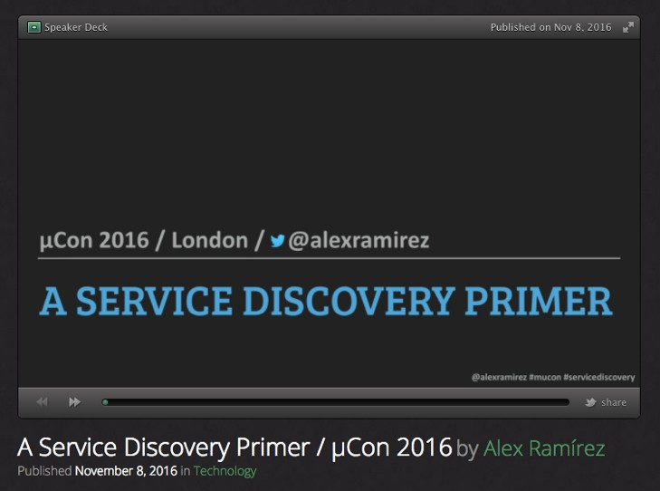
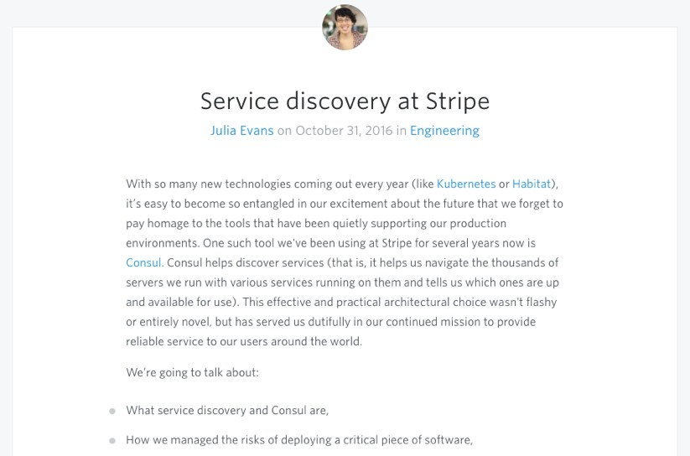
A Service Discovery Primer Alex Ramírez
Service Discovery at Stripe Julia Evans

Slide 123




Thanks!

